Slide 1
Integration Step Size Method

Slide 2
Numerical Integration
When doing numerical integration it is important to pick the correct step size and integration method
It is also important to determine how far to integrate
These parameters can be set in Simulink from the menu item Simulation / Configuration Parameters…

Slide 3
Numerical Integration
The first item is often the easiest to determine, Simulation Time
  Enter the start and stop time in seconds

Slide 4
Numerical Integration
The second item is the Solver option “Type”
  This allows Variable or Fixed Step Size
  Normally leave this at variable step size because Simulink will try to estimate a good step size to use (long where it can shorter when necessary)

Slide 5
Numerical Integration
Slow here
(long steps)
With variable step size Simulink automatically adjusts the size.
For orbits:
  the step size will be smaller when things are changing rapidly (near perigee)
  the step size will be larger when things are changing slowly (near apogee)
Fast here
(short steps)

Slide 6
Numerical Integration
The third item is the Solver option “Solver”
  This allows the integration method to be selected.
  Normally pick the highest order method available (in this case ode5 or ode45)
  Higher orders usually allow bigger step sizes to be taken without loss of accuracy

Slide 7
Numerical Integration
The forth item is the Solver option “Fixed Step Size”
  This is only visible if Fixed Step size has been selected under “Type”
  Picking a good value can sometimes be difficult (so the variable step size option will often bail us out.)
  However, variable step size does not always work as desired.

Slide 8
Numerical Integration
Helpful Hint!!!
When you have selected the Type: Fixed Step and then you switch back to Type: Variable Step, Simulink sets the Solver option to discrete. This is not what we want for most of our projects (and will often cause errors,) so be sure to switch it back to ode45.

Slide 9
Numerical Integration
Another important item is the Solver option “Relative Tolerance”
  This is only visible if Variable Step size has been selected under “Type”
  This tells us how much error is acceptable at each step
  To get a more accurate answer make this value smaller
  You may need to do this for your big Simulink project

Slide 10
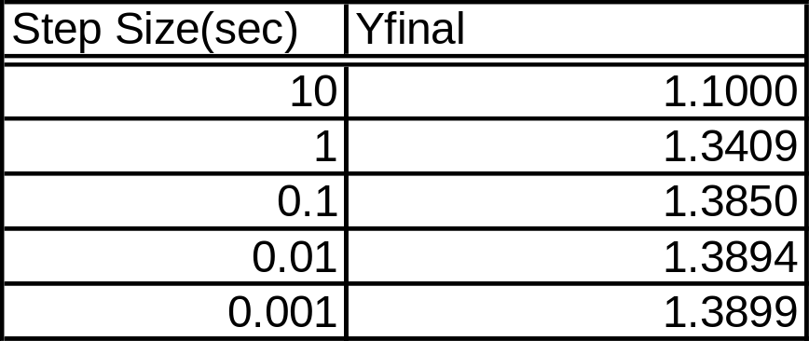
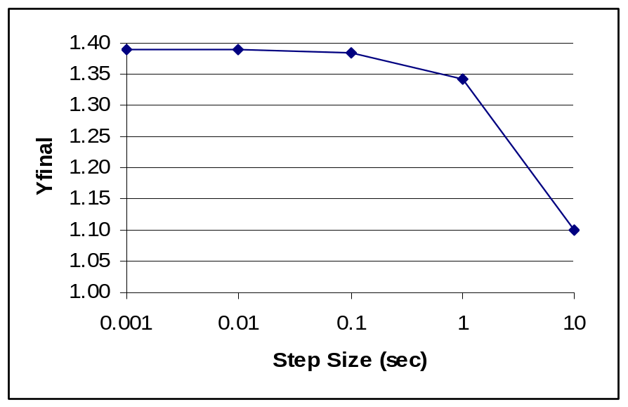
Numerical Integration
As a rough estimate of numerical accuracy, the step size can be varied by factors of ten. Then plot the solution vs the time step (on a log scale)
This gives an idea of how close the step size seems to be getting to the true solution.

Slide 11
Numerical Integration
There are better, more accurate, methods for determining accuracy, but this gives a good rough estimate for us.

Slide 12
Numerical Integration
A better way to determine the accuracy is to compare the results to a known solution
For example for 2-body orbit propagation, integrate the object for exactly one period and see how close it comes to it’s original position

Slide 13
Numerical Integration
On the next page we compare solutions from various step sizes to the exact answer

Slide 14
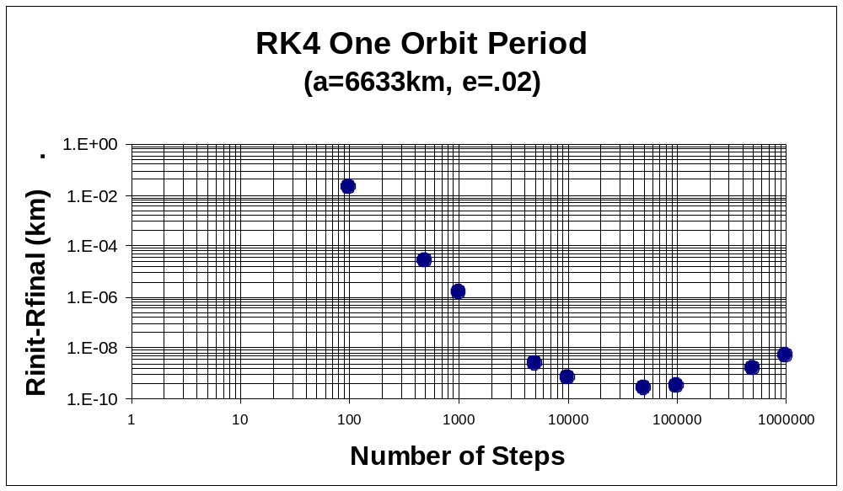
1000000 steps takes very long to propagate, but we can also see that the accuracy is degrading due to round off.

Slide 15
Numerical Integration
As an exercise, we are going to look at the effects of step size and we will try to determine an acceptable step size.
  Too large of a step will give a large error
  Too small of a step will take too long and may introduce round off error

Slide 16
Numerical Integration
Use the integration model from last time but add a display block to the “y” component

Slide 17
Numerical Integration
Go into the Configuration Parameters and select fixed step size, ode1 and a step size of 10
Record the final value
Then repeat the process using step sizes of 1, 0.1, 0.01, …
What is the “best” step size? Why?

